Slide 1
Loan| Finance Project
Data ANALYSIS
Bank

Slide 2
About Project-245
Content
ANALYSIS
Data ANALYSIS
This is Bank loan of Customers project where we were provided with 2 datasets with Finance-1.csv and Finance-2.xlsx extension files having 39k rows each and the objective was to analyze the bank loans got within given years and we did calculations, merging the data and to prepare interactive dashboards.

Slide 3

Group Members Deatils
Data ANALYSIS
Project No : P245
Reporting Person : Bharath Group Member Names :
Ekta Rajesh Lanjewar
Raja Shekar Reddy
Mirza Ruman Baig
Jangapally Sridhar
Shrinidhi Mutanal
Tenzin Tsegha
Chetan Chandrakant Jagadale

Slide 4
TABLE OF CONTENT
Grade & Sub Garde Wise Revol Balance
Year Wise Loan Stats
KPI-01
Total Pay of Verified & Not Verified
State Wise/ Month Wise Loan Status
Data ANALYSIS
KPI-02
Year wise Loan Amount Issued to Customers
Customers Grading wise Revol Balance
KPI-03
KPI-04
Customers Verification wise Payment
Individual States Wise Loan Stats and Amount
Continued…..

Slide 5
TABLE OF CONTENT
Home Ownership wise Last Payment Date
KPI-05
Data ANALYSIS
Customer Home Ownership (rent, owner etc..) Wise Loan Amount

Slide 6




Tools Used to Analize
MS Excel
SQL
Power Bi
Tableau
Data ANALYSIS

Slide 7
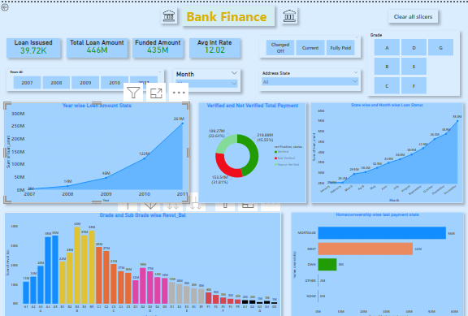
Data ANALYSIS
$ 39717
$ 445 M
Total No of Loan Issued
Total Loan Amount
$ 434 M
12.02%
Total Fund Amount
Avg Interest rate

Slide 8
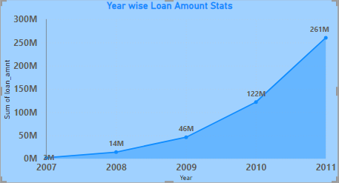
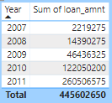
KPI-1 Year Wise Loan Stats
Data ANALYSIS
By analysing the chart we can see how Loan Amount is increasing by year.
Starts from 2007 the loan amount is 22,19,275 and in the 2011 the loan amount is 26,05,06,575. We can clearly Show the growth from 2007 to 2011 by subtracting the value of 26,05,06,575 from the value of – 22,19,275, which equals 25,82,87,300.
The 44,56,02,650.00 loan amount that the bank provided to its Customers.

Slide 9
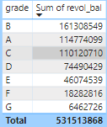
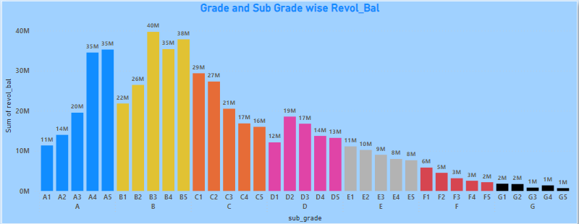
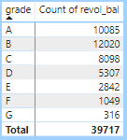
KPI-2 Grade & Sub Garde Wise Revol Balance
Data ANALYSIS
In this Grade and subgrade wise revol balance we can notice Grade-B have more revol balance then any other grade & Grade-G have very low revol balance. Grand Total of Revol Balance = 53,15,13,868.00 This matric table clearly illustrates the number of Customers who fall into grade wise .

Slide 10
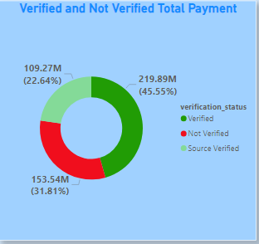
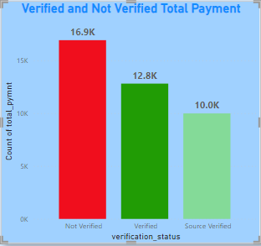
KPI-3 Total Pay of Verified & Not Verified
Data ANALYSIS
With this level, the verification procedure will start. Customers must submit a loan application to the bank. when the bank The application verification process will start collecting data. We may view the total amount paid for various verification statuses in the Donut Chat. Looking at the donut chart, we can see that the verified status has 45.55% of the total payment of 219.89 million, the source verified status has 22.64% of the total payment of 109.27 million, and the not verified status has 31.81% of the total payment of 153.54 million.

Slide 11
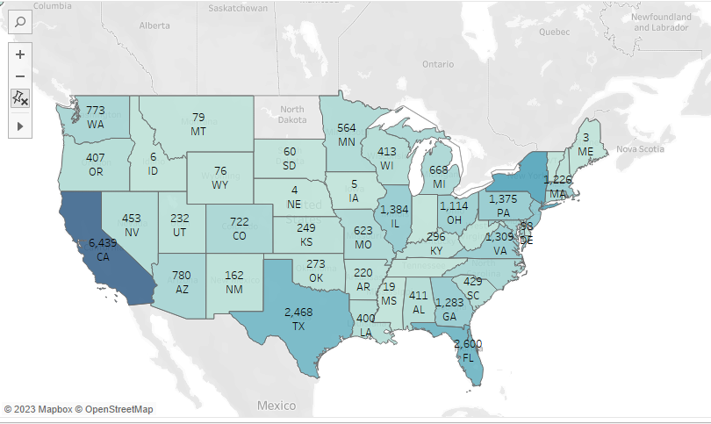
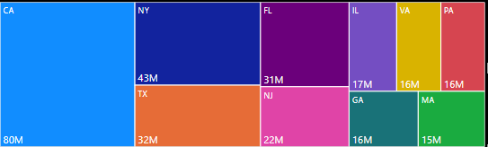
KPI-4 State Wise/ Month Wise Loan Status
Data ANALYSIS
The Map on the right displays the number of loans in each state in the USA. As we can see, CA provided loans to customer with loan status count of over 5000 + and ME is the least state provide loan to customers.

Slide 12
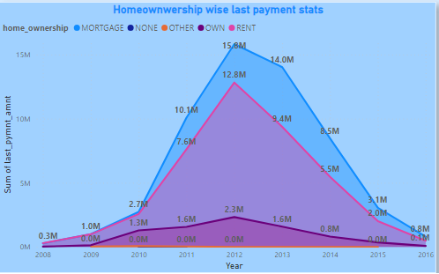
KPI-5 Home Ownership wise Last Payment Date
Data ANALYSIS
The Area Chart shows, Home ownership and the amount paid for each year. Maximum Amount Paid by Mortgage home ownership in 2012 with amount of 15.6 M

Slide 13
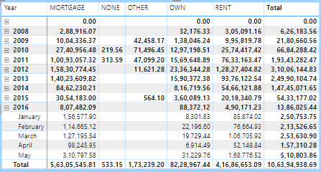
KPI-5 Home Ownership wise Last Payment Date
Data ANALYSIS
The report comes to the conclusion that many of the Customers are about to pay back the loan balance for their specific house ownership. With the exception of NONE and OTHERS, home owners have taken out the most loans for debt consolidation. Thus, the highest amount lately paid was on a mortgage, followed by rent and own.

Slide 14
Thank You
Data ANALYSIS
presentation By Group-5

